Slide 1
Vehicle Door Proximity Sensor
B2-04
Abhijeet Kumar - COE19B036
Ashwani Verma - MFD19B014
Ausaf Ahmad - COE19B048
Mayank Raj - COE19B027
Santosh Dangi - MFD19I021

Slide 2
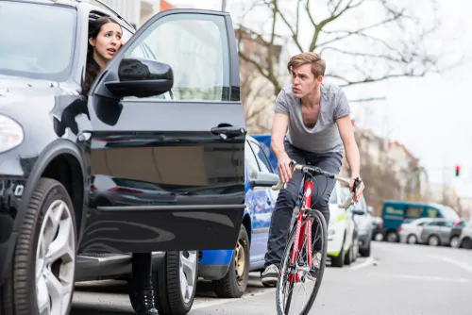
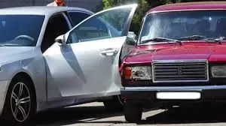
Problem Statement:
While travelling peoples in car unknowingly opens the doors for unloading or for spitting without paying attention about what is coming from behind and which results into an fierce accident.

Slide 3
Solution 1 :
1.We are proposing a device that will give a warning if someone tries to open the door when any vehicle is passing by.
How our device works?
-. Device includes an ultrasonic sensor which is fixed at the back end of car and sensors at the door latch of car. When ultrasonic sensor senses any vehicle arriving from behind and at the same time any passenger in the car tries to open the gate then this device gives a warning alarm. So that the passenger can check around and then open it.
In this way, we can reduce the number of accidents caused by such behaviour.

Slide 4
Solution-2 Using Digital image processing:
We will use the vehicle camera/dashcam to analyze the vehicles approaching from the rear and use digital image processing to cross-check the speed and distance of the moving vehicles behind us.

Slide 5
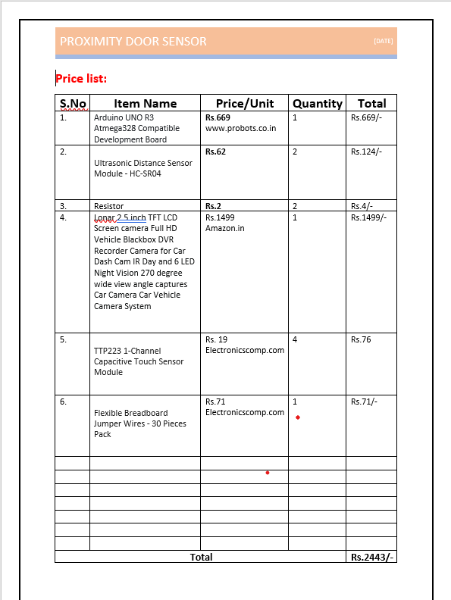
Price list:

Slide 6
Some ways through which we can calculate distance of object with camera
Improving distance measurement with camera calibration.
Stereo vision and depth cameras to measure distance.
LiDAR can be used with camera data to provide highly accurate distance measurements.
F = (P x D) / W to find focal length
then , D’ = (W x F) / P
Where W is actual width of the object(in inch/metre)
P is apparent width in pixel

Slide 7
Code for measuring distance
Find distance from camera to object using Python and OpenCV
# import the necessary packages
from imutils import paths
import numpy as np
import imutils
import cv2
def find_marker(image):
# convert the image to grayscale, blur it, and detect edges
gray = cv2.cvtColor(image, cv2.COLOR_BGR2GRAY)
gray = cv2.GaussianBlur(gray, (5, 5), 0)
edged = cv2.Canny(gray, 35, 125)
# find the contours in the edged image and keep the largest one;
# we'll assume that this is our piece of paper in the image
cnts = cv2.findContours(edged.copy(), cv2.RETR_LIST, cv2.CHAIN_APPROX_SIMPLE)
cnts = imutils.grab_contours(cnts)
c = max(cnts, key = cv2.contourArea)
# compute the bounding box of the of the paper region and return it
return cv2.minAreaRect(c)
def distance_to_camera(knownWidth, focalLength, perWidth):
# compute and return the distance from the maker to the camera
return (knownWidth * focalLength) / perWidth
# initialize the known distance from the camera to the object, which
# in this case is 24 inches

Slide 8
Codes continued….
KNOWN_DISTANCE = 24.0
# initialize the known object width, which in this case, the piece of
# paper is 12 inches wide
KNOWN_WIDTH = 11.0
# load the furst image that contains an object that is KNOWN TO BE 2 feet
# from our camera, then find the paper marker in the image, and initialize
# the focal length
image = cv2.imread("images/2ft.png")
marker = find_marker(image)
focalLength = (marker[1][0] * KNOWN_DISTANCE) / KNOWN_WIDTH
# loop over the images
for imagePath in sorted(paths.list_images("images")):
# load the image, find the marker in the image, then compute the
# distance to the marker from the camera
image = cv2.imread(imagePath)
marker = find_marker(image)
inches = distance_to_camera(KNOWN_WIDTH, focalLength, marker[1][0])
# draw a bounding box around the image and display it
box = cv2.cv.BoxPoints(marker) if imutils.is_cv2() else cv2.boxPoints(marker)
box = np.int0(box)
cv2.drawContours(image, [box], -1, (0, 255, 0), 2)
cv2.putText(image, "%.2fft" % (inches / 12),
(image.shape[1] - 200, image.shape[0] - 20), cv2.FONT_HERSHEY_SIMPLEX,
2.0, (0, 255, 0), 3)
cv2.imshow("image", image)
cv2.waitKey(0)

Slide 9
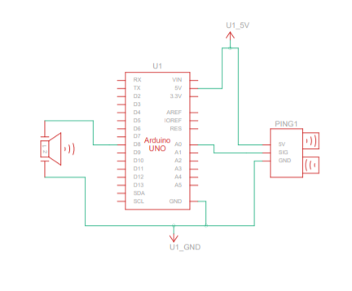
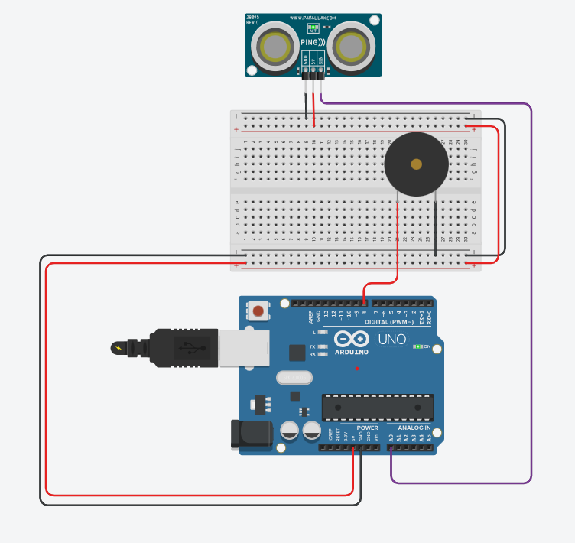
Ultrasonic sound Sensor Design in TinkerCad:

Slide 10
Simulation code of circuit
// C++ code
//
int distance = 0;
long readUltrasonicDistance(int triggerPin, int echoPin)
{
pinMode(triggerPin, OUTPUT); // Clear the trigger
digitalWrite(triggerPin, LOW);
delayMicroseconds(2);
// Sets the trigger pin to HIGH state for 10 microseconds
digitalWrite(triggerPin, HIGH);
delayMicroseconds(10);
digitalWrite(triggerPin, LOW);
pinMode(echoPin, INPUT);
// Reads the echo pin, and returns the sound wave travel time in microseconds
return pulseIn(echoPin, HIGH);
}
void setup()
{
pinMode(8, OUTPUT);
pinMode(8, OUTPUT);
}
void loop()
{
// Santosh Dangi-MFD19I021
distance = 0.01723 * readUltrasonicDistance(A0, A0);
if (distance < 100) {
tone(8, 523, 1000); // play tone 60 (C5 = 523 Hz)
} else {
digitalWrite(8, LOW);
}
delay(10); // Delay a little bit to improve simulation performance
}

Slide 11
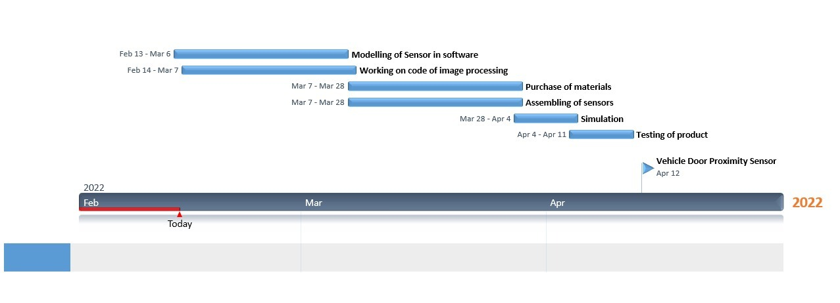
GANNT CHART:

Slide 12
Work distribution:
14/02/2022
Work | Name of the student
Modelling of sensor and coding for sensor | Santosh Dangi- MFD19I021 Ashwani Verma- MFD19I014
Code development for image processing | Mayank – COE19B027 Ausaf Ahmad- COE19B048 Abhijeet – COE19B036
Assembling of sensor | Santosh Dangi- MFD19I021 Ashwani Verma- MFD19I014
Connecting camera with senosr | Mayank – COE19B027 Ausaf Ahmad- COE19B048 Abhijeet – COE19B036

Slide 13
Work distribution cont.
Purchase of materials | Santosh Dangi- MFD19I021 Ashwani Verma- MFD19I014
PPT preparation and updation | Santosh Dangi- MFD19I021 Ashwani Verma- MFD19I014

